Slide 1
Logit and Probit Models
SSI II
March 7, 2019

Slide 2
Previously…
Regression
OLS assumptions
Type of test you do depends on variable types

Slide 3
Essential Questions
How do we do regression if we have a dummy dependent variable?
Bonus: How do we control for unit or group effects?

Slide 4
Types of Tests
 |  | Independent Variable Type
Dependent Variable Type |  | Categorical | Continuous
 | Categorical | Tabular Analysis | Probit/Logit
 | Continuous | Difference of Means | Correlation Coefficient; Bivariate Regression Model

Slide 5
When?
Dummy DV
Logit or probit
Ordinal DV
Ordinal logit or probit
Other, more complicated, non-continuous DVs

Slide 6
Think in Probability
Given the IVs, what is the probability the DV will be a 1?
This can allow us to think about a linear or s-shaped probability distribution

Slide 7
Linear Probability Model
Assume an underlying linear probability distribution
P(Y=1) is a linear function of the Xs
OLS with a dummy DV
Interpretation: For every one unit change in X, the probability of Y being equal to 1 increases on average by β units

Slide 8
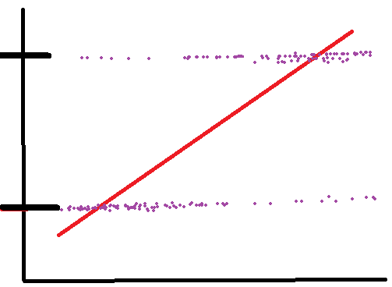
Linear Probability Model (LPM)
1
Vote
0
Education

Slide 9
LPM Problems
Error term is not normally distributed
Either 0 or 1
Intrinsic heteroskedasticity, with larger error variance at the middle values
So OLS will be inefficient
May get values smaller than 0 or larger than 1
The effect may not be the same at all probabilities
X may have more of an effect at the middle
Problem with the functional form

Slide 10
Functional Form Example
Education and voter turnout
Changing from no high school degree to one year of college may have more of an effect than changing from year 4 to year 5 of graduate school
This makes it non-linear

Slide 11
Functional Form Should be:
Non-linear – with more impact at the middle
Bounded between 0 and 1
Solution: Some S-shaped or sigmoid function
The logistic function
Hence, logistic regression

Slide 12
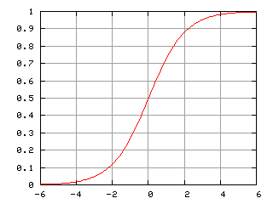
The (Cumulative) Logistic Function

Slide 13
The Logit Model
As XB goes to ∞, P(Y=1) goes to 1, but never gets there
As XB goes to -∞, P(Y=1) goes to 0, but never gets there
When XB is 0, P(Y=1)=.5

Slide 14
The “Odds” That Y=1
The “Odds” are P(Y=1)/P(Y=0)
Through some algebra…
(1-P(Y=1)) =

Slide 15
Linear in the Logits
By taking the log of the odds, we get the “logit” of Y
The logit model is linear in the logits
So, a one unit change in X has a linear effect on the change in the log-odds that P(Y=1)

Slide 16
Latent Propensity Variable
There is an underlying, latent, continuous variable, that is unobserved
This variable represents the propensity of the DV occurring
What is your propensity to vote?
Usually denoted as Y*
If Y* is greater than a certain threshold τ, then the observed Y=1, if it is less than τ, the observed Y=0

Slide 17
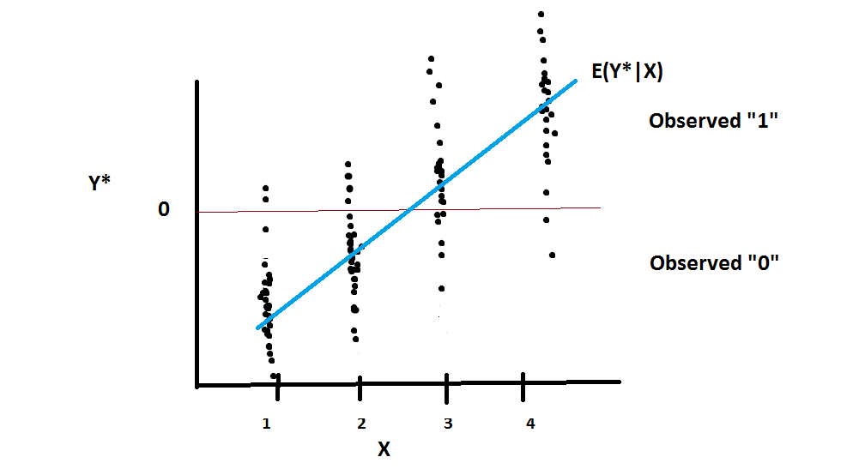
Latent Propensity

Slide 18
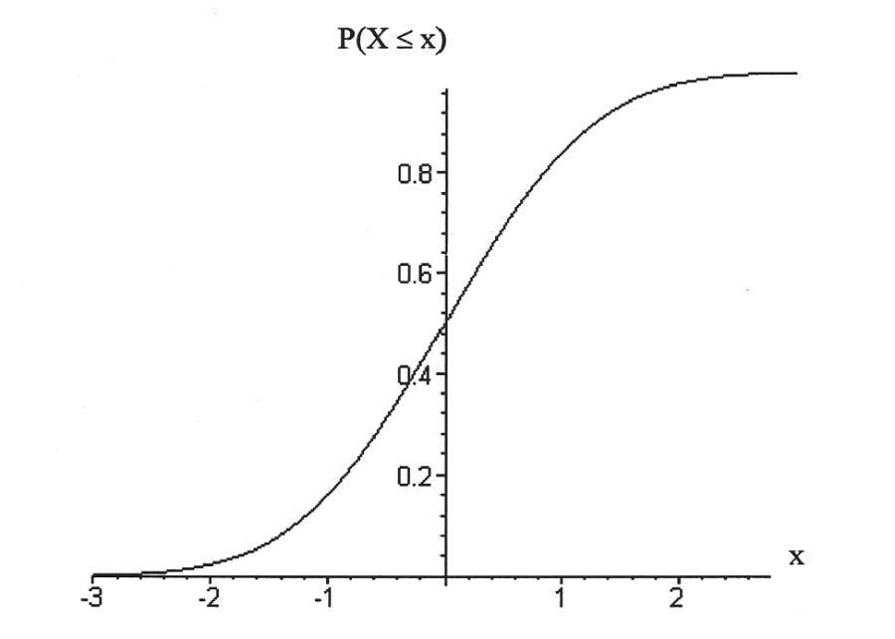
Cumulative Normal Distribution Function

Slide 19
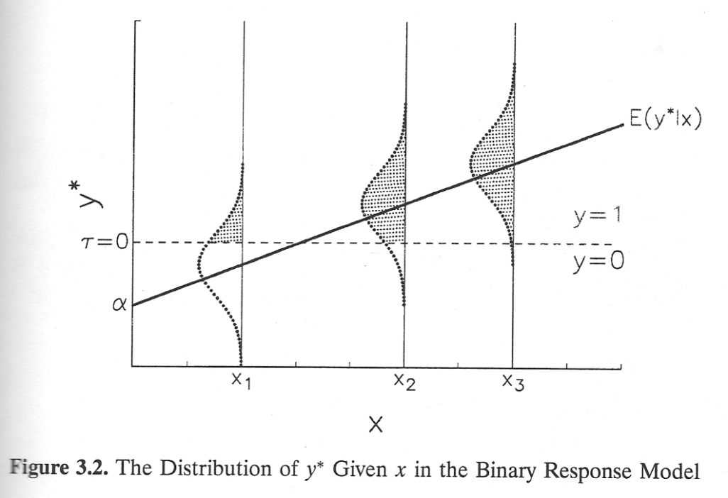
The Probit Model

Slide 20
The Probit model
Basically: What is the probability that the error term is large enough it would push us over the threshold and change the observed value?
Use the normal curve to find these probabilities

Slide 21
Probit Model
The probit model is linear in the z-scores and non-linear in the probabilities
The probability that Y=1 is equal to the cdf (the value of the cumulative normal distribution function) associated with the z-score for the quantity XB

Slide 22
In R
mylogit <- glm(DV ~ IV1 + IV2, data=mydata, family=binomial)
myprobit <- glm(DV ~ IV1 + IV2, data=mydata, family=binomial(link=“probit”))

Slide 23
Interpretation Options - Linear
The linear effect of X on the probit z-scores or the logit log-odds and odds
For every unit change in X, we expect a β change in the z-score (probit) or the log-odds (logit)
For every unit change in X, we expect a ___ factor change (multiplicative change) in the odds (logit)
The linear effect of X on Y* in probit
For every unit change in X, we expect a β change in the in the latent propensity or utility of Y*

Slide 24
Interpretation Options – Non-linear
Non-linear effect of X on P(Y=1)
For every unit change in X, there will be a different change in the P(Y=1), depending on where X is on the cumulative logistic or cumulative normal function
Small changes at extremes, larger changes in the middle

Slide 25
Interpretation Options – Predicted Probabilities
The predicted probability that Y=1 given certain values of the X variables
We usually give predicted probabilities at various levels of one X variable, while holding all other X variables at their mean/mode/certain values

Slide 26
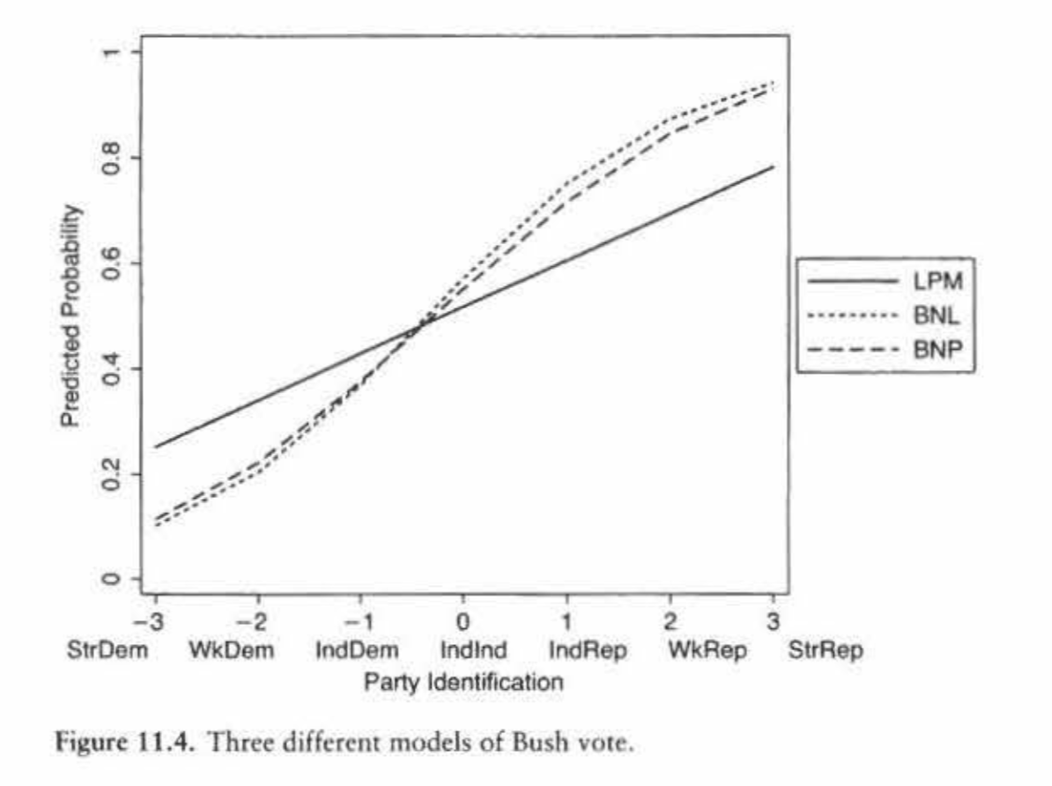
Predicted Probabilities - Example
Notes:
Source: Kellstedt and Whitten (2008)

Slide 27
Example - Turnover
Legislative turnover – what % of members are different, or have turned over, in a period of time?
The Council of the European Union
The Council is made up of national ministers
Below them are bureaucrats called permanent representatives
Research Question: If there is more turnover at the ministerial level, do bureaucrats make more of the decisions?

Slide 28
Example - Turnover
Unit of Analysis
Piece of legislation
Main IV
Annual ministerial turnover, rolling
Measured in the month of the final Council decision
DV
Ministerial decision – “B point”
Bureaucratic/Committee decision – “A point”
Logistic regression

Slide 29
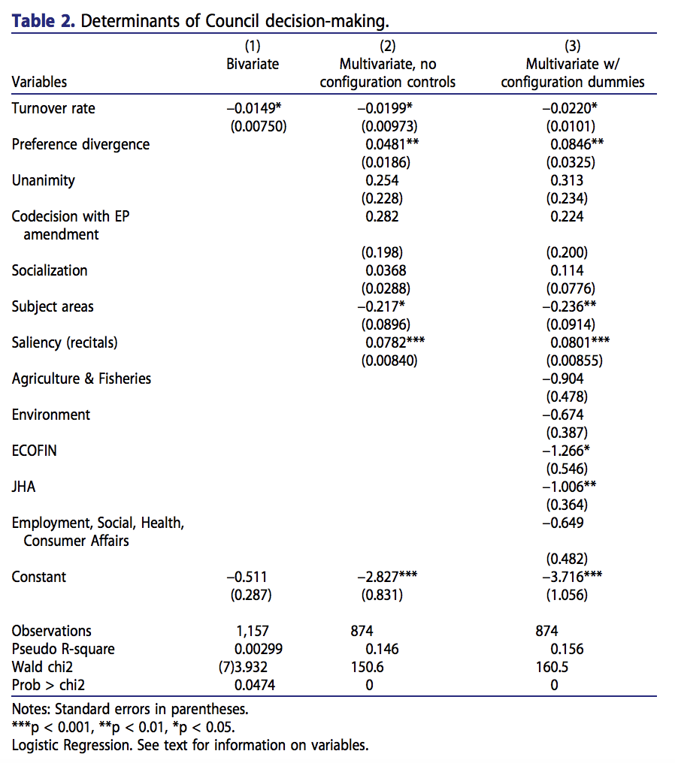

Slide 30
Interpreting Turnover - Overview
“The results in Table 2 suggest that turnover is an important and significant predictor of whether decisions are made at the ministerial or committee level. This holds true across all models. The relationship supports the second hypothesis – increased turnover at the ministerial level makes committee-level decisions in the Council more likely.”

Slide 31
Interpreting Turnover - Significance
“Turnover is negative and significant at the 0.05 level in all models (p = 0.047, p = 0.041, and p = 0.029).”

Slide 32
Interpreting Turnover – Factor Change in the Odds
“A 1 per cent decrease in the turnover rate increases the odds of a ministerial decision by a factor of between 1.5 per cent (model 1) and 2.2 per cent (model 3).”
… holding all other variables constant

Slide 33
Interpreting Turnover – Predicted Probabilities
“When turnover is at its observed maximum of 65.63 per cent, the models predict that the probability of a ministerial decision is about 0.16. When turnover is at its observed minimum, 16.66 per cent, the predicted probability is about 0.34.”
… when all other variables are at their means

Slide 34
Interpreting Turnover – Substantive Comparison
“In order to understand the real effect of turnover in the Council, one can compare the predicted probabilities at the average rate of annual turnover for the Council, around 35 per cent, to the average rate for the EP and national parliaments, around 9 per cent. Elevated turnover in the Council leads to a difference of between 0.08 and 0.12 in the predicted probability that ministers make a decision.”

Slide 35
Interpreting a Control Variable
“As expected, the preference divergence variable is significant at the 0.01 level (p = 0.010, p = 0.009).”
“The coefficient is positive, suggesting that greater differences among member state preferences make it more likely that ministers decide.”
“A change from the minimum (20.1) to the maximum (37.2) predicts a 0.14 (model 2) or a 0.24 (model 3) increase in the probability of a ministerial decision.”

Slide 36
Interpreting Insignificant Controls
“The variables for unanimity, EP involvement and socialization are not significant in any model.”

Slide 37
Configuration Controls
A dummy variable for each Council configuration (except a reference category)
Helps deal with non-independence of errors from unobserved factors affecting all legislation handled by a single configuration
Similar to regional dummy variables that Koch & Nicholson include
Equivalent to “fixed effects”

Slide 38
Configuration Controls - Interpretation
“The configuration controls suggest that the Transport, Telecommunications, and Energy Council is the most distinct. When it is included in the model, it is usually significant and positive, suggesting that ministers in this configuration are more likely to make decisions. When it is not in the model, as in those presented here, more configurations are significant than in any other version of the model. Agriculture and Fisheries, Environment, Economic and Financial Affairs, and Justice and Home Affairs are all significantly less likely to have ministers make decisions.”

Slide 39
Why fixed effects?
Possible heteroskedasticity
Non-independence of errors
Unobserved heterogeneity

Slide 40
Heteroskedasticity
Units or groups that are low on the regression line may have more or less variance than those high on the regression line
Units at the extremes may have less variation than those at the middle of the distribution

Slide 41
Non-independent Errors
If a unit or a group is above average once, it will likely be above average again
Due to unobserved factors not included in the model
These are currently all in the error term
Since they are in the error term repeatedly, the errors will be correlated

Slide 42
Unobserved heterogeneity
Those unobserved factors that we just talked about present a form of omitted variable bias
We almost always cannot measure all relevant factors
Now there is essentially a U_{i} term in addition to our normal error term
Represents unobserved, stable factors
Called a “unit effect"

Slide 43
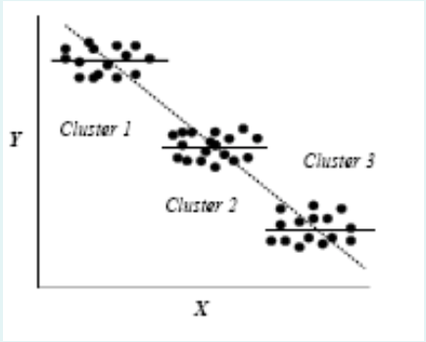
Implications of U
Every unit or group has its own intercept, alpha + U
Beta estimates will be biased if the U term is related to X variables

Slide 44
Including Dummy Variables/Fixed Effects
Calculates a different intercept for every unit/group
Remember you need to leave one out!
Still assumes constant slopes across units/groups
Is this problematic? It depends on your data!

Slide 45
Koch & Nicholson
“We… include dummy variables for each of the 11 districts to account for district-level differences.”
What are some of the possible district-level differences you could imagine?
This is one of the differences between the model we’ve estimated thus far and the model they have estimated.
How do you think this might explain some of the differences we’ve seen?

Slide 46
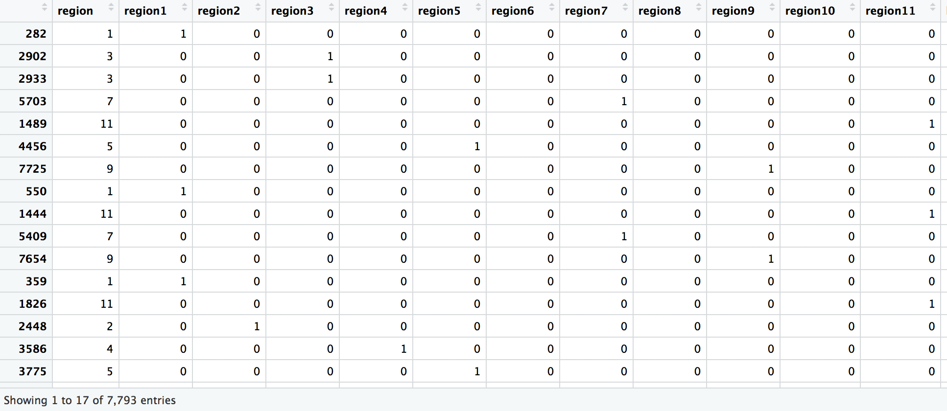
Regional Dummy Variables

Slide 47
Essential Questions
How do we do regression if we have a dummy dependent variable?
Bonus: How do we control for unit or group effects?

Slide 48
Next Time…
Clustered Standard Errors
Wrap-up
Spring preview

